Slide 1
A Smart Platform for Personalized Travel Discovery and AI-Based Trip Planning
Technologies: React • Node.js • Express • MySQL • Ollama • Llama 3.2 • Google Maps
6th Grade
Presented by:
Janumpally Hansika | N. Rishika Chowdary | B. Nikita

Slide 2
Introduction
India Guide is a smart tourism platform designed to simplify the travel-planning process.
Explore tourist destinations across India
AI-powered travel assistance
Personalized day-wise trip planning
Interactive Google Maps
Save favorite destinations
Store and manage planned trips
Secure user authentication
“From destination discovery to a personalized itinerary - everything in one platform.”

Slide 3
Problem Statement
Travel planning requires users to search across multiple platforms for destinations, maps, travel information, and itineraries.
Creating a personalized day-wise itinerary based on budget, duration, interests, and travel preferences is often time-consuming.
Existing travel platforms may provide destination listings and maps, but users still need to manually combine information to build a complete trip plan.
AI-based planning can generate itineraries quickly, but generated recommendations may contain inaccurate or impractical information if they are not grounded in reliable destination data.

Slide 4
Proposed Solution
India Guide is a cloud-based AI-powered tourism platform that integrates travel discovery, personalized trip planning, maps, and trip management into a single system.
Destination Discovery – Explore states and tourist destinations across India.
AI Travel Assistant – Get intelligent travel-related assistance.
Personalized Trip Planner – Generate day-wise itineraries based on user requirements.
Google Maps Integration – View destinations and routes on interactive maps.
Saved Places – Save and manage favorite destinations.
Trip Management – Store and access planned trips from the cloud.
Custom Planning – Create itineraries by manually selecting destinations.

Slide 5
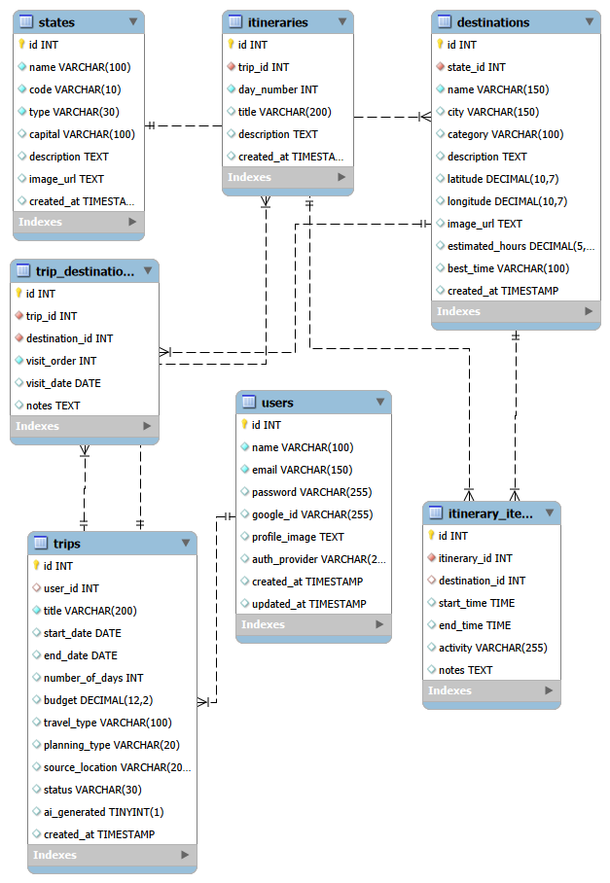
System Architecture

Slide 6
Technologies Used
Component | Technology
Frontend | React + Vite
Backend | Node.js + Express
Database | Cloud MySQL
AI Model | Llama 3.2
AI Runtime | Ollama / Hosted AI
Maps | Google Maps API
API Communication | REST + JSON
Authentication | Token-based Authentication
Cloud Hosting | Cloud Platform
Version Control | Git + GitHub

Slide 7
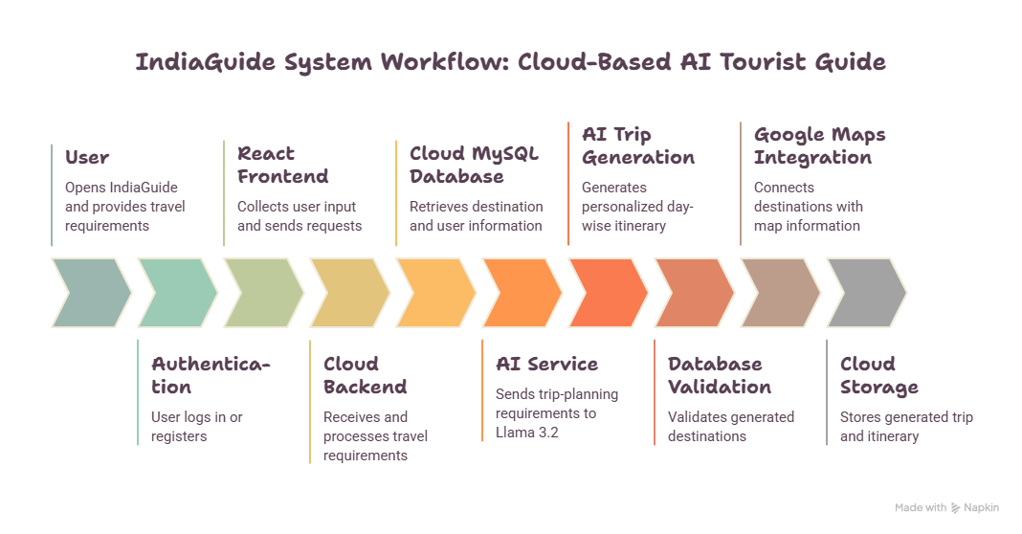

Slide 8
Results
Destination Exploration
Users can browse states and tourist destinations.
AI Travel Assistant
Provides AI-powered travel-related responses.
Personalized Trip Planning
Generates day-wise itineraries based on user requirements.
Database Validation
AI-generated destinations are checked against stored tourism data.
Google Maps Integration
Displays destinations and route information.
Trip Management
Users can save and access their planned trips.
Cloud-Ready Architecture
Frontend, backend, database and AI services are designed as separate components.

Slide 9
Future Scope
Real-time weather integration
Hotel and transportation services
Voice-based AI assistant
Multilingual support
Real-time location recommendations
Mobile application
Advanced cloud scaling and monitoring

Slide 10
THANK YOU

